Slide 1
Introduction to problem solving

Slide 2
Six Methods of PS
Identify the problem
Understand the problem
Identify alternative ways to solve the problem
Select the best way to solve the problem from the list of alternative solutions
List instructions that enable you to solve the problem using the selected solution
Evaluate the solution

Slide 3
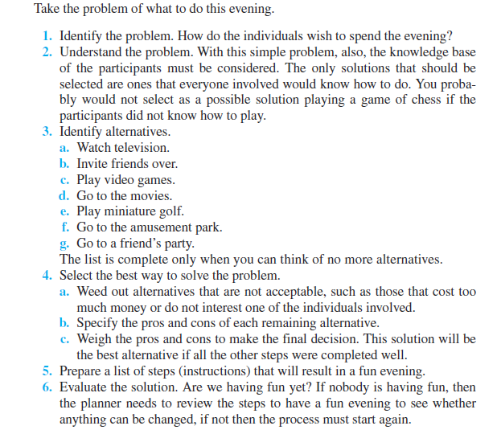

Slide 4
Types Of Problem
Decision Problems
A decision problem is a problem for which the answer for every valid input is yes or no. Deciding whether a number is prime, odd or even are both examples of decision problems.

Slide 5
Search Problems
A search problem is a problem which requires the identification of a solution from within a potentially infinite set of possible solutions. The answer is a string of some sort - or a string representation of other data types. For example, finding the factors of a number or finding the n^{th} prime number.
Counting Problems
A counting problem requires a total of the solutions to a search problem. For example, 'how many of the first 100 integers are prime?'.

Slide 6
Optimization Problems
Optimization problems require the identification of the best solution to a search problem from a given set of solutions.

Slide 7
Problem Solving with Computers

Slide 8
Problem Solving
Problem solving is a process of transforming the description of a problem into the solution of that problem by using our knowledge of the problem domain and by relying on our ability to select and use appropriate problem-solving Strategies, Techniques and Tools.
Problem solving (with in the context of developing programs) refers to analyzing a problem with the intention of deriving a solution for the problem.
Using computer’s in problem solving.

Slide 9
Steps in Problem solving
Requirements specifications (Specification of needs).
Problem analysis.
Design the algorithm to solve the problem.
Implementation.
Testing and verification.
Documentation

Slide 10
Requirements Specifications:
State the problem clearly and unambiguously (Doubtless) to understand exactly:
What the problem is?
What is needed to solve it?
What the solution should provide
If there are constraints and special conditions.

Slide 11
Problem Analysis
In the analysis phase, we should identity the following:
Inputs: To the problem, their form and the input media to be used.
Outputs: Expected from the problem, their form and the output media to be used.
Special constraints or (necessity) conditions (if any).
Formulas or equations to be used

Slide 12
Example: Problem:
Compute and display the total cost of apples given the number of kilograms (kg) of apples purchased and the cost per kg of apples.
Input: Quantity of Apples purchased (in kg).
Cost per kg of Apples (in Rs. per kg).
Output: Total cost of Apples (in Rs.)
Constraint: N/A
Formula: Total cost = Cost per kg x Quantity.

Slide 13
Design the algorithm to solve the problem.
An algorithm is a list of steps to be executed with the right order in which these steps should be executed.
An algorithm must satisfy these requirements:
It must have and Input.
It must have an Output.
It must not be ambiguous (there should not be different interpretations to it).
It must be general (it can be used for different Inputs).

Slide 14
Algorithm
A set of sequential steps usually written in Ordinary Language to solve a given problem is called Algorithm.
Suppose we want to find the average of three numbers, the algorithm
Step 1 Read the numbers a, b, c
Step 2 Compute the sum of a, b and c
Step 3 Divide the sum by 3
Step 4 Store the result in variable d
Step 5 Print the value of d
Step 6 End of the program

Slide 15
IMPLEMENTATION
The process of implementing an algorithm by writing a computer program using a programming language (example: using ‘c’ language)
The output of the program must be the solution of the intended problem

Slide 16
TESTING AND VERIFICATION
Program testing is the process of executing a program to demonstrate its correctness.
Program verification is the process of ensuring that a program meets user requirement
After the program is compiled we must run the program and test/verify it with different inputs before the program can be released to the public or other users (or to the instructor of this class)

Slide 17
DOCUMENTATION
contains details produced at all stages of the program development cycle.
Can be done in 2 ways
• writing comments between your line of codes.
• Creating a separate text file to explain the program.
Important not only for other people to use or modify your program, but also for
you to understand your own program after along time.

Slide 18
Documentation is so important because
You may return to this program in future to use whole of or a part of it again.
Other programmer or end user will need some information about your program for reference (or) maintenance.
You may some day have to modify the program, or may discover some errors or weakness in your program.
Although documentation is listed as the last stage of software development method, it is actually an or going process which should be done from the very beginning of the software development process

Slide 19
Algorithm

Slide 20
Algorithm
Algorithm is a set of well defined instructions in sequence to solve the problem.
Qualities of a good algorithm
Input and output should be defined precisely.
Each steps in algorithm should be clear and unambiguous.
Algorithm should be most effective among many different ways to solve a problem.
An algorithm shouldn't have computer code. Instead, the algorithm should be written in such a way that, it can be used in similar programming languages.

Slide 21
Write an algorithm to add two numbers entered by user.
Step 1: Start
Step 2: Declare variables num1, num2 and sum.
Step 3: Read values num1 and num2.
Step 4: Add num1 and num2 and assign the result to sum. sum←num1+num2
Step 5: Display sum
Step 6: Stop

Slide 22
Write an algorithm to find the largest among three different numbers
Step 1: Start
Step 2: Declare variables a,b and c.
Step 3: Read variables a,b and c.
Step 4: If a>b
If a>c
Display a is the largest number.
Else
Display c is the largest number.
Else
If b>c
Display b is the largest number.
Else
Display c is the greatest number.
Step 5: Stop

Slide 23
write an algorithm to find the area and circumference of the circle.
Write an algorithm to find given number odd or even.
Write an algorithm to find the factorial of a number.
Write an algorithm to check whether a number entered by user is prime or not.

Slide 24
Pseudo Code
It’s simply an implementation of an algorithm in the form of annotations and informative text written in plain English.
It has no syntax like any of the programming language and thus can’t be compiled or interpreted by the computer.
Improves the readability of any approach. It’s one of the best approaches to start implementation of an algorithm.
The main goal of a pseudo code is to explain what exactly each line of a program should do, hence making the code construction phase easier for the programmer.

Slide 25
Pseudo Code for Adding two numbers
BEGIN
input num 1,num 2
sum = num 1 + num 2
diplay total
END

Slide 26
Write an pseudocode to find the largest among three different numbers

Slide 27
1. READ the values of 3 numbers A, B and C
2. IF the value of A>that of B THEN
GOTO step 3
ELSE
GOTO step 4
ENDIF
3. IF the value of A>that of C THEN
PRINT "The maximum value is that of A"
GOTO step 5
ELSE
GOTO step 4
ENDIF

Slide 28
4. IF the value of B>that of C THEN
PRINT "The maximum value is that of B"
GOTO step 5
ELSE
PRINT "The maximum value is that of C"
GOTO step 5
ENDIF
5. STOP processing

Slide 29
Write pseudo code that reads two numbers and multiplies them together and print out their product.
Write pseudo code that tells a user that the number they entered is not a 5 or a 6

Slide 30
Pseudo code
Read num1 , num2
Set multi to num1*num2
Write multi

Slide 31
Pseudo Code:
Read isfive
If(isfive = 5)
Write "your number is 5“
Else if (isfive = 6)
Write "your number is 6"
Else
Write "your number is not 5 or 6"

Slide 32
Flowchart
Pictorial representation of an algorithm
Uses different shapes of boxes
Logical flow is indicated by interconnecting arrows

Slide 33
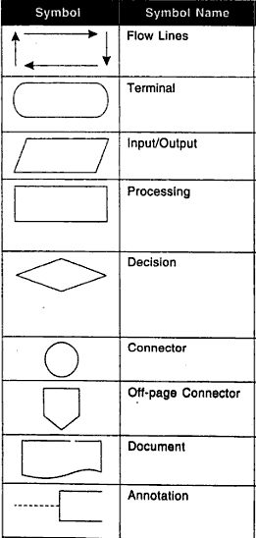
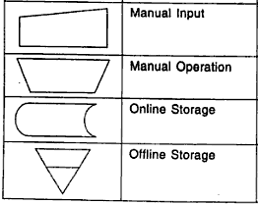
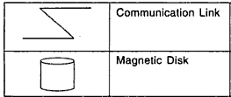
Flow Chart symbols

Slide 34
Guidelines to prepare a flowchart
Clear, neat and easy to follow
Must have logical start and finish
Requirements must specified in logical order
Direction of the flow line should be always from left to right or top to bottom
Only one flow line should come out from a process symbol.
If necessary connectors can be used
Can be tested manually

Slide 35
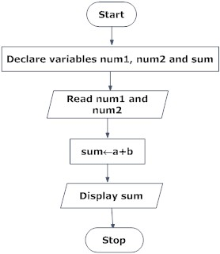
Flowchart - Example
Draw a flowchart to add two numbers entered by user.

